Slide 1
Deep reinforcement learning applied to doom
Students
Mehdi Boubnan
Ayman Chaouki
Supervisor
Alessandro Lazaric

Slide 2
Project
Training agent to play some DOOM scenarios
Environment : ViZDoom
Deep Reinforcement Learning
Value based methods
Hybrid methods

Slide 3
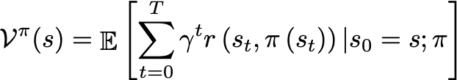
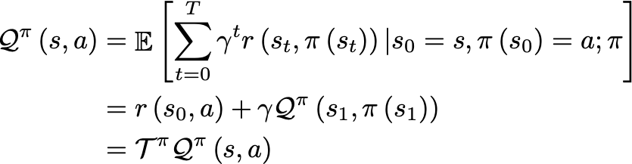
Brief recap
The optimal Q value function is the fixed point of
Notes:
Parler de exact solutions pour passer au deep

Slide 4
Exact solution
Value iteration
Markov Decision Process
Dynamic programming
Policy iteration
It does not apply when transition probabilities are not provided
Limitation
It requires exact representation of value functions and policies (hard when the state space is huge)
Notes:
Up to a chosen constant |

Slide 5
deep reinforcement learning
Approximate reinforcement learning
Uses a “smaller” space to approximate state-action value functions.
Deep reinforcement learning
Uses neural networks to perform the approximation

Slide 6
Value based methods

Slide 7
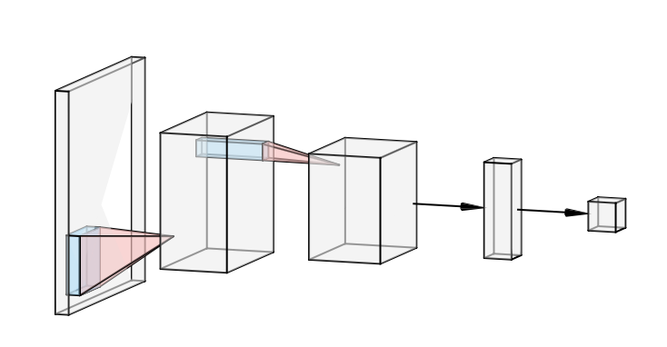
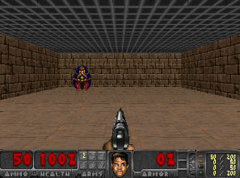
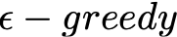

DEEP Q-LEARNING
State
Q-values
- s -
|
|
|
|
|
|
|
|
|
Next state
- s’ -
Action
Reward
- a -
- r -
Transition (s, a, r, s’)

Slide 8
deep Q-learning
Loss
Transitions (s, a, r, s’)
Decorrelate experiences.
Avoid overwriting weights.
Replay Buffer
Container that stores transitions (s, a, r, s’)
Training
Train on randomly sampled batch of transitions from replay buffer

Slide 9
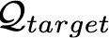
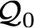
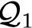
DOUBLE deep Q-learning
Problem of DQN
Loss oscillates a lot during training.
We choose the action using the same network that computes
We chase a moving target at each iteration
DQN
Action “a”
copy weights each steps
Target DQN

Slide 10
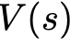
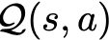
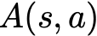
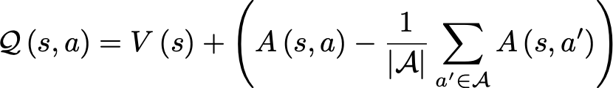
dUELlING deep Q-learning
Two streams
Value stream : estimates value function at state s
Advantage stream : estimates advantage for each action a at state s
Aggregation layer
Estimates Q values as follows :

Slide 11
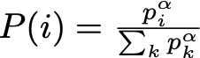
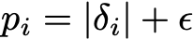
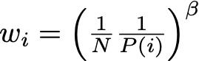
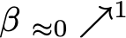
PRIORITIZED EXPERIENCE REPLAY
Instead of uniformly sampling experiences, we prioritize those with high TD error to improve training
Proportional prioritization
Probabilities
with
Introduces bias
Avoid bias with importance sampling weights
Loss is weighted by

Slide 12
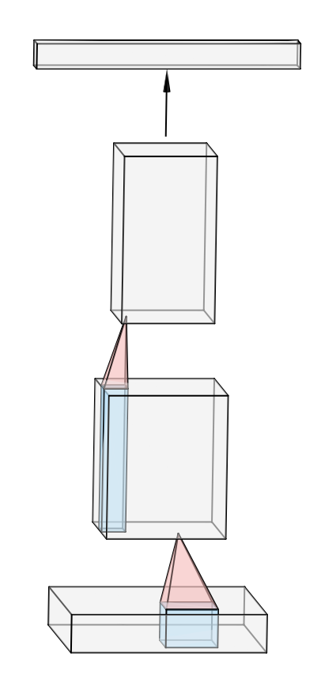
deep RECURRENT Q-learning
----
----
LSTM
----

Slide 13
HYBRID methods

Slide 14
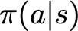
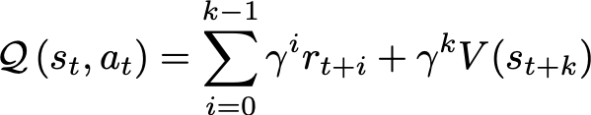
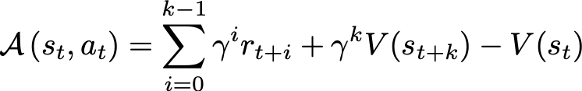
ASYNCHRONOUS ADVANTAGE Actor-CRITIC
Critic
Actor-Critic
Actor
Advantage

Slide 15
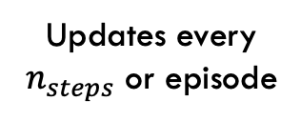
ASYNCHRONOUS ADVANTAGE Actor-CRITIC
Asynchronous
Updates every $n_{steps}$ or episode
1
Worker 1
2
Worker 2
3
Worker 3
…
n
Worker n
Notes:
It is called asynchronous because it relies on n workers

Slide 16
ASYNCHRONOUS ADVANTAGE Actor-CRITIC
Losses
Value function loss
Policy loss
Entropy loss to encourage exploration

Slide 17
CURIOSITY DRIVEN LEARNING
Curiosity tackles one main problem
Sparsity of rewards
Proposed approach
Introducing an additional intrinsic reward
Based on the ability to predict next state given current state and action
Encourage exploring new unseen states

Slide 18
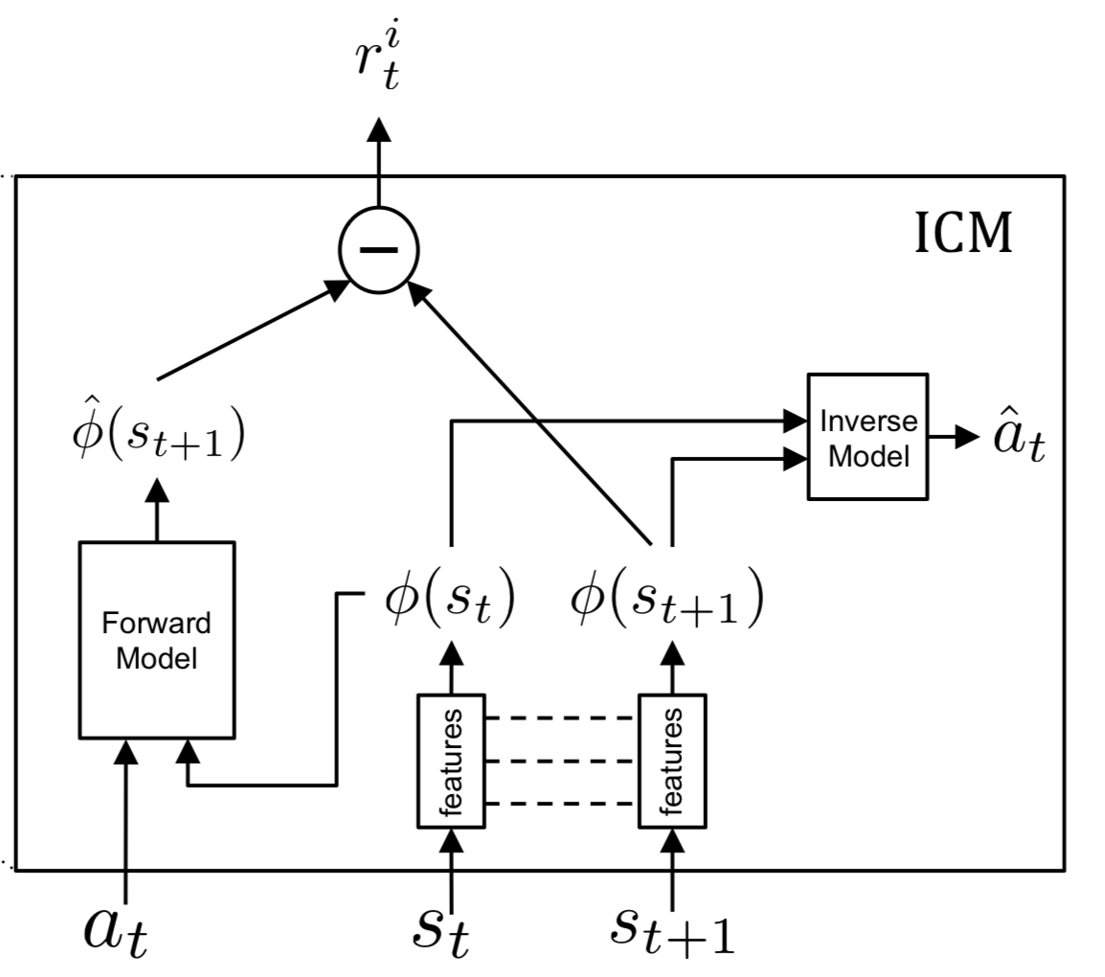
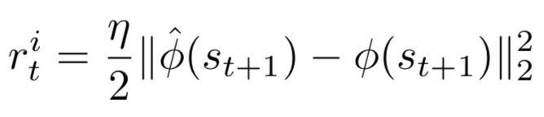
CURIOSITY DRIVEN LEARNING
Embedding
This approach is noise-sensitive in the raw sensory space
Learn a state embedding that is invariant to noise
Model
Uses two models : Forward model & Inverse model
Notes:
Two states different in a way that is not related/cause by the agent will have the same embedding | error constitutes the intrinsic reward

Slide 19
EXPERIMENTS

Slide 20
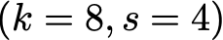
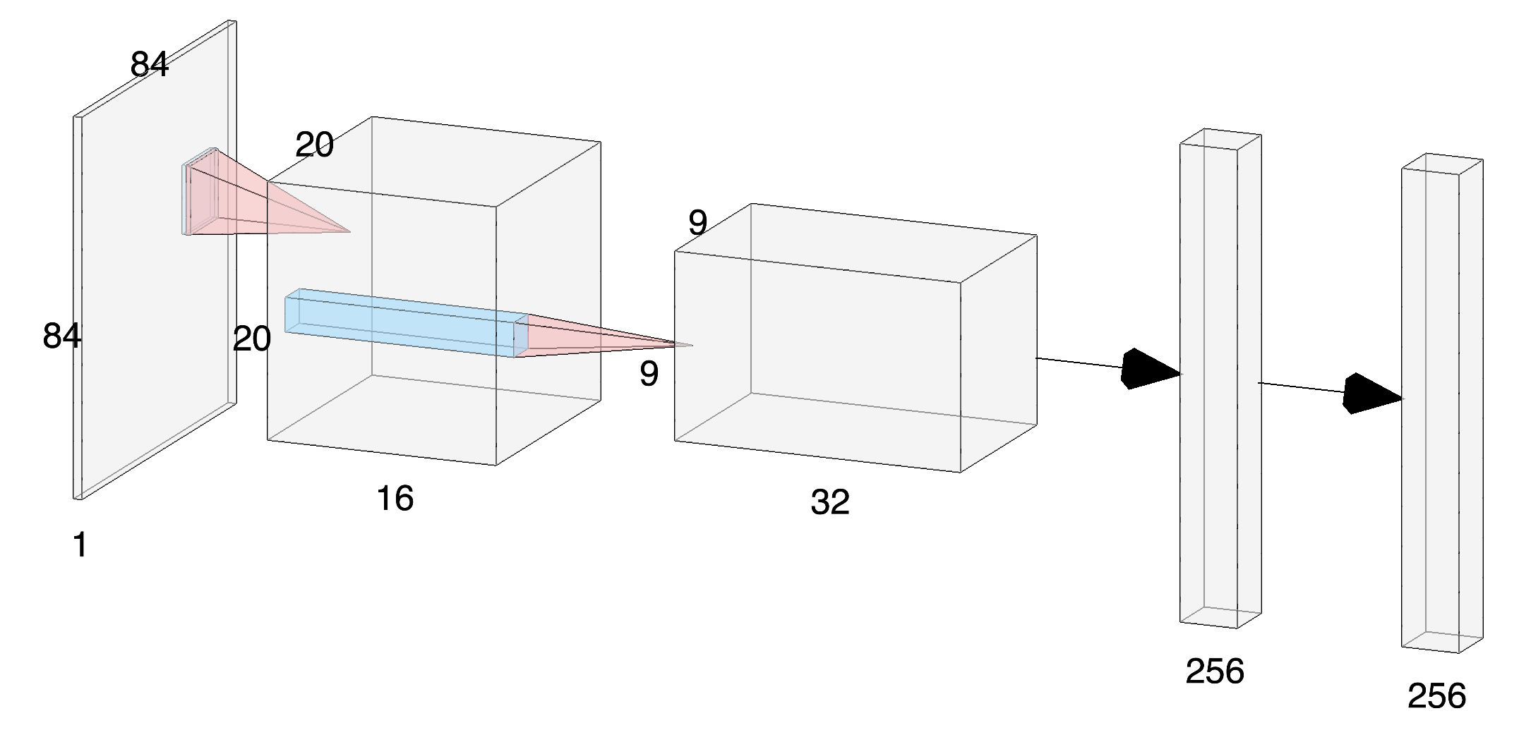
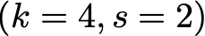
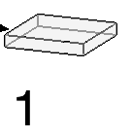

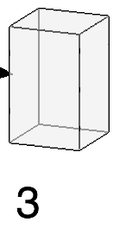
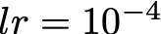
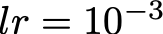
A3C and Curiosity
A3C Parameters
Network parameters
Optimizer : Adam with
Clipping gradients by 40 to avoid overconfidence that leads to bad moves.
Curiosity Parameters
Optimizer : Adam with
Same gradients clipping

Slide 21
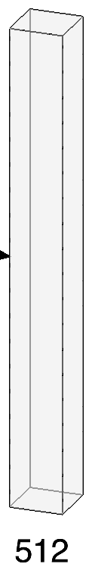
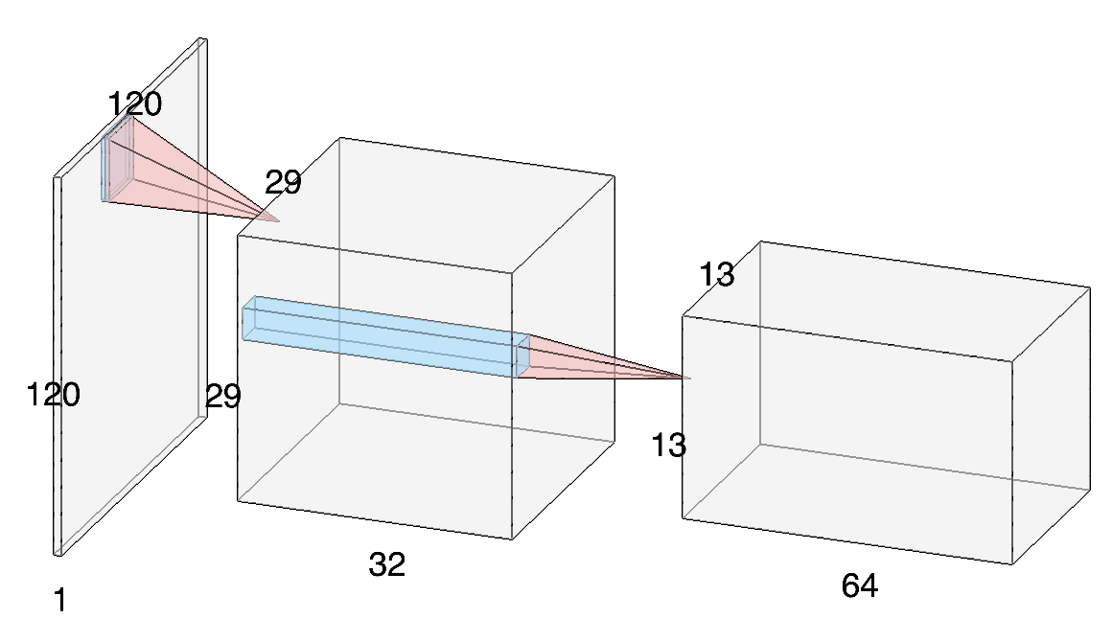
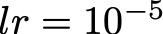
DDDQN
DDDQN Parameters
Network parameters
Optimizer : Adam with
Replay memory size : 16 384
Target network update step : 1024

Slide 22
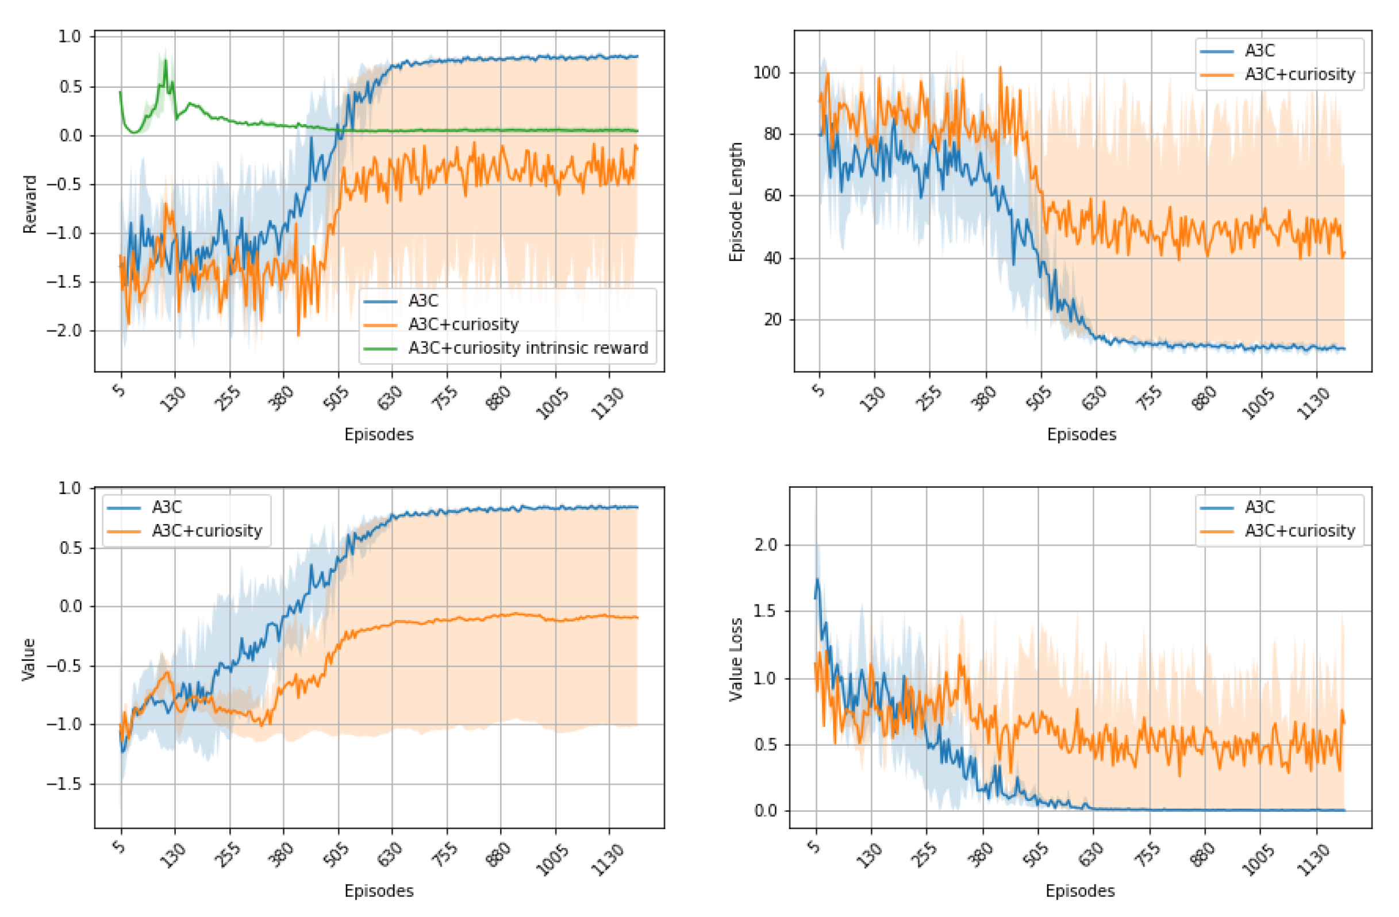
SEEK AND DESTROY
A3C + Curiosity Results
Kill reward : +100
Living reward : -1
/100
Ammo reward : -5
A3C : Convergence to the optimal policy
A3C + Curiosity : Convergence to a suboptimal policy

Slide 23
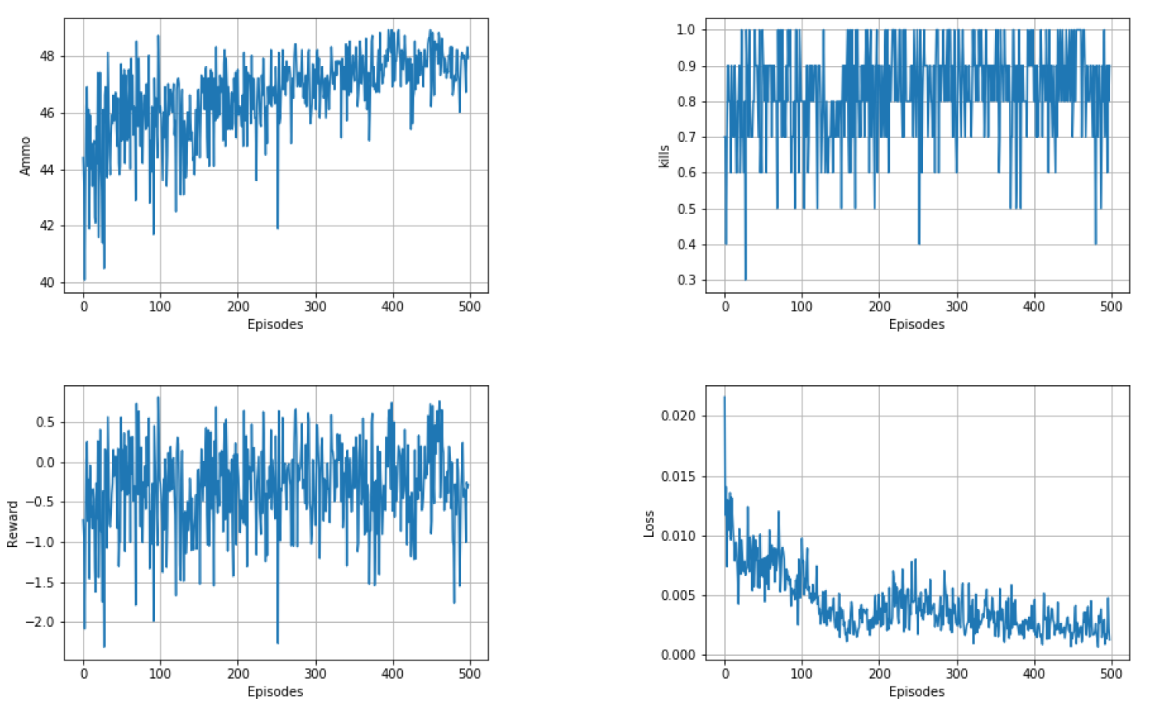
SEEK AND DESTROY
DDDQN Results
Kill reward : +100
Living reward : -1
Ammo reward : -5
Convergence to suboptimal policy.
Very unstable learning.

Slide 24
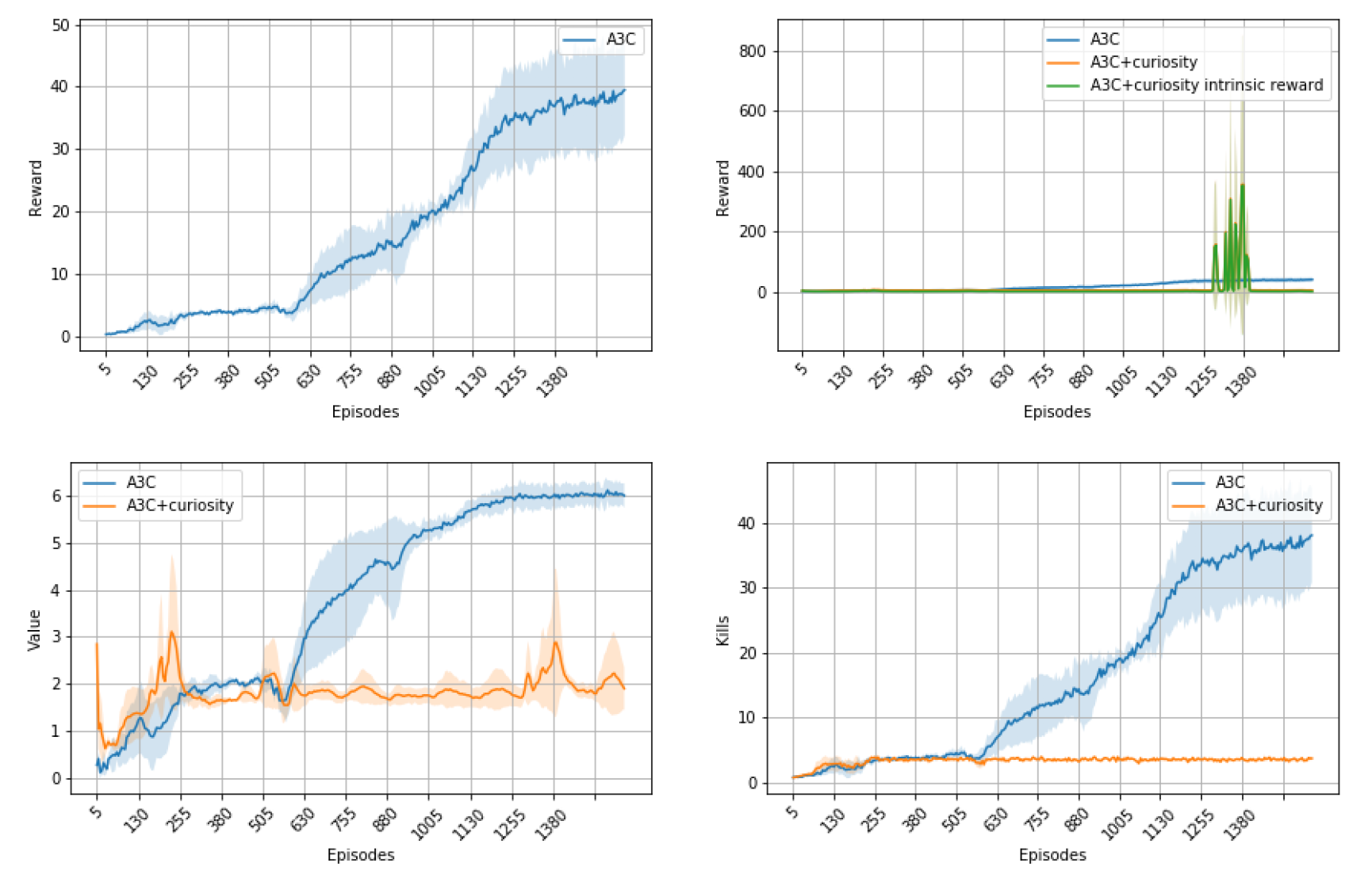
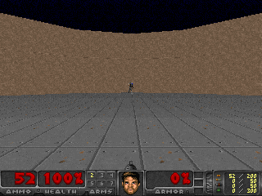
DEFEND THE CENTER
A3C + Curiosity Results
Kill reward : +1
Death penalty : -1
Ammo reward : -0.5
A3C : Convergence to the optimal policy
A3C + Curiosity : No convergence + high variance of states (hard state embedding)

Slide 25
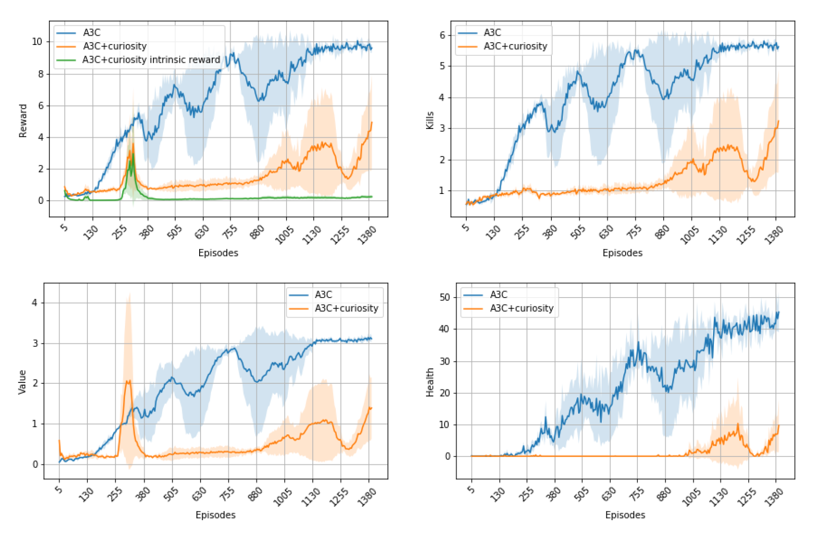
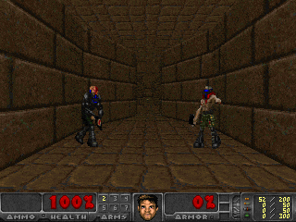
Deadly corridor
A3C + Curiosity Results
Game reward :
/5
Kill reward : 100
/100
Taking damage : -5
Ammo reward : -0.5
A3C : Convergence (the agent always attains his goal)
A3C + Curiosity : Intrinsic reward perturbates training and likely puts the weights in topology difficult to recover from.

Slide 26
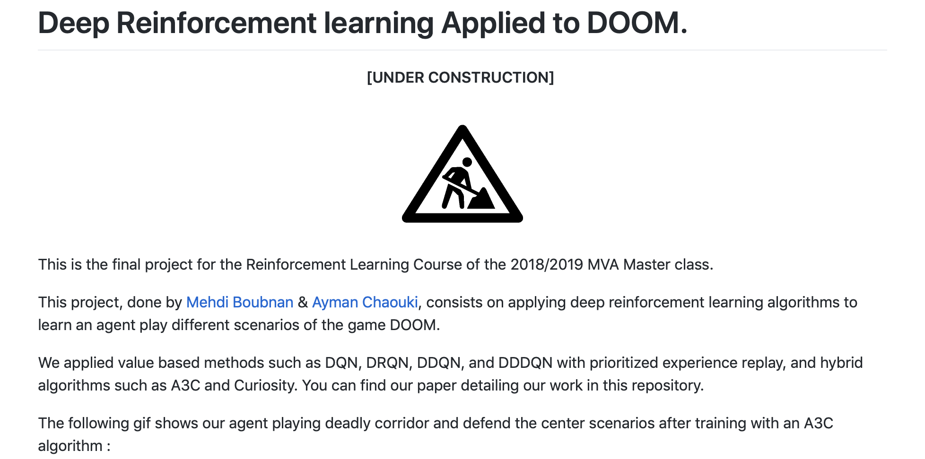
https://github.com/Swirler/Deep-Reinforcement-Learning-applied-to-DOOM

Slide 27
REFERENCES
[1] Micha l Kempka, Marek Wydmuch, Grzegorz Runc, Jakub Toczek, and Wojciech Jáskowski. ViZDoom: A Doom-based AI research platform for visual reinforcement learning. In IEEE Conference on Computational Intelligence
[2] Volodymyr Mnih, Koray Kavukcuoglu, David Silver, Alex Graves, Ioannis Antonoglou, Daan Wierstra, and Martin Riedmiller. Playing atari with deep reinforcement learning. arXiv preprint arXiv:1312.5602, 2013
[3] Hado Van Hasselt, Arthur Guez, and David Silver. Deep reinforcement learning with double q-learning. In AAAI, volume 2, page 5. Phoenix, AZ, 2016.
[4] Ziyu Wang, Tom Schaul, Matteo Hessel, Hado Van Hasselt, Marc Lanctot, and Nando De Freitas. Dueling network architectures for deep reinforcement learning. arXiv preprint arXiv:1511.06581, 2015.
[5] Matthew Hausknecht and Peter Stone. Deep recurrent q-learning for partially observable mdps. CoRR, abs/1507.06527, 7(1), 2015.
[6] Volodymyr Mnih, Adria Puigdomenech Badia, Mehdi Mirza, Alex Graves, Timothy Lillicrap, Tim Harley, David Silver, and Koray Kavukcuoglu. Asynchronous methods for deep reinforcement learning. In International conference on machine learning, pages 1928–1937, 2016.
[7] Deepak Pathak, Pulkit Agrawal, Alexei A Efros, and Trevor Darrell. Curiosity-driven exploration by self supervised prediction. In International Conference on Machine Learning (ICML), volume 2017, 2017.

